Slide 1
CS111: Operating Systems Principles
Lab 1C: Profiling the Simpleton Shell
Midterm Review!
Vishwas Suryanarayanan

Slide 2
Problem 1C: Compare your shell to others
Full Description here: https://web.cs.ucla.edu/classes/winter19/cs111/assign/lab1.html
Setup:
Development environment with gcc, glibc, make, gdb
Goal:
Profile simpsh to compare to bash and dash
Come up with at least 3 non-trivial benchmark commands
Submit:
Tar ball with source module, Makefile, README and Report

Slide 3
getrusage (2)
Include:
#include <sys/time.h> #include <sys/resource.h>
Function Definition:
int getrusage(int who, struct rusage *usage);
who?
RUSAGE_SELF
RUSAGE_CHILDREN
RUSAGE_THREAD
Returns: 0 and -1

Slide 4
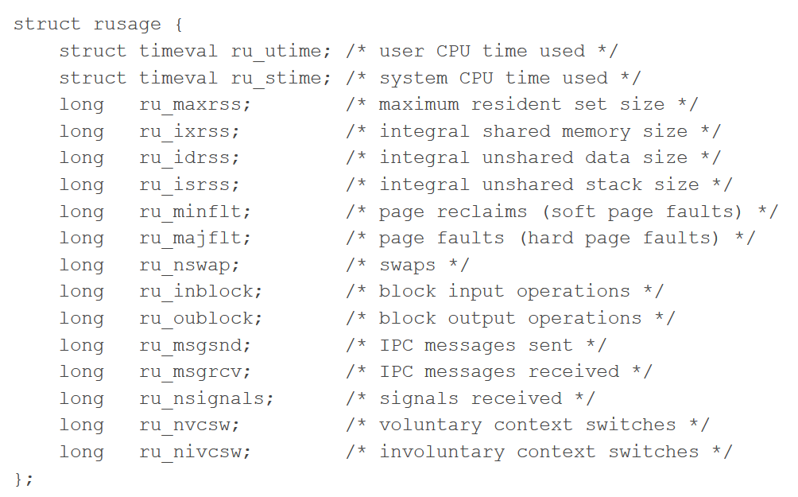
Structure definition

Slide 5
struct timeval
struct timeval {
time_t tv_sec; /* seconds */
suseconds_t tv_usec; /* microseconds */
};
For reference:
Epoch: 1970-01-01 00:00:00 +0000 (UTC)
Call before and after, and report the difference.
Values are not floating point -> they are integral values.
Operations in the user space count towards user time
Operations in the kernel space (system calls) count towards system time.

Slide 6
times (2)
Bash command to profile a shell script
Gives statistics for the current shell
Invoke a new shell with bash –c “Non-trivial benchmark here; times;”
Output:
User Time System Time User Time (child) System Time (child)
The children must have been `wait`ed for
Reiteration:
Operations in the user space count towards user time
Operations in the kernel space (system calls) count towards system time.

Slide 7
Questions?

Slide 8
Midterm Review
Winter 2017 Paper for CS-111
Remember:
Open Book, Open Notes
Closed devices
Assignments are also important!

Slide 9
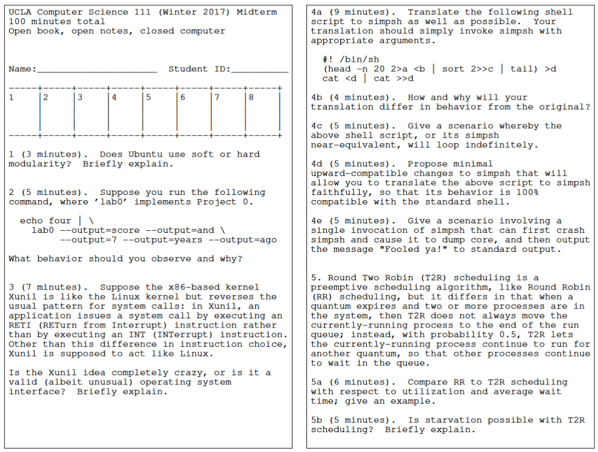

Slide 10
